Slide 1
Design of training activities
2nd Training in Saltillo, MEX
17-20th of December 2018
JOAQUÍN GAIRÍN SALÁN (UAB)
"The European Commission support for the production of this publication does not constitute an endorsement of the contents which reflects the views only of the authors, and the Commission cannot be held responsible for any use which may be made of the information contained therein.“
FOR EDUCATIONAL PURPOSE ONLY

Slide 2
Curricular models (Ferrández)
Training focuses
LEARNING
SUBJECT (INDIVIDUAL)
MEMORY
TECHNÉ
ACADEMIC
TECHNOLOGICAL
HUMAN
H
I
KNOWLEDGE
(KNOW HOW,
TECHNIQUES
TECHNOLOGY)
I
STIC
MODEL
MODEL
USE OF
KNOWLEDGE
HUMANISTIC
HUMANISTIC
CR
CR
I
I
TICAL
TICAL
MODEL
MODEL
PRACTICE
PRAXIS
DECIDING SUBJECT (PERSON)

Slide 3
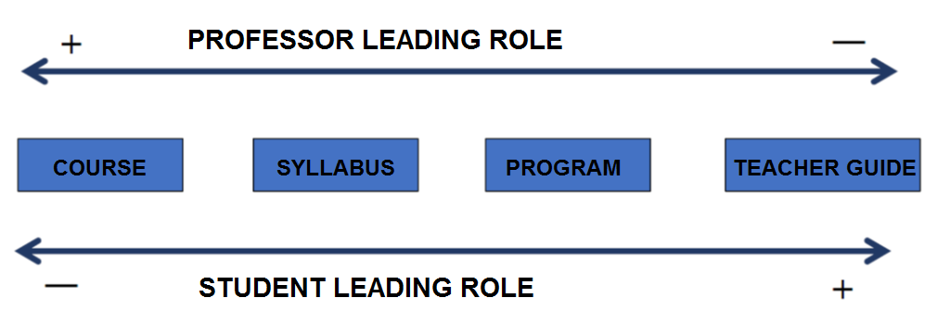
The evolution of training intervention systems

Slide 4
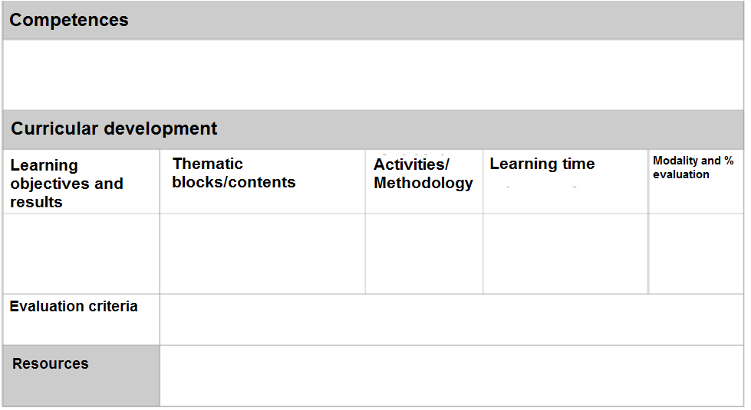
Educational proposal

Slide 5
Educational proposal
 |  |  |  | FOLLOW UP
ACTIONS | DECISION MAKERS | RESOURCES | TIMING | Who/how will execute it | Expected outcome | Supporting facts | Adjustments required
WHAT ACTION | WHAT OBJECTIVE | INVOLVED FOR WHAT PURPOSE | WHO EXECUTES | WHAT DEVELOPMENT (Stages, dimension, operation, etc.) | WHAT EVALUATION (What, how, when, etc.) | WHAT MEANS (Existing, to be obtained)

Slide 6
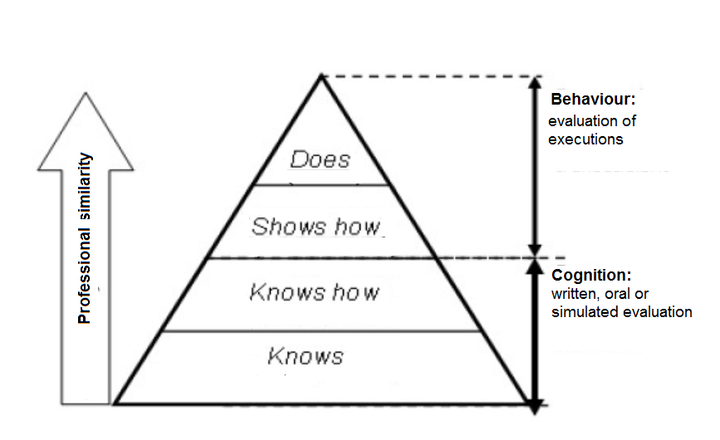
Program elements. Competencies and objectives

Slide 7
Towards competence delimitation/Objectives
AREA OF IMPROVEMENT/ EXISTING NEEDS | PRIORITY |  |  |  | JUSTIFICATION
 | 1 | 2 | 3 | 4
STARTING SITUATION/EXISTING NEEDS | IMPROVEMENT DESIRED/SATISFIED NEEDS | DELIMITATION OF COMPETENCES/ OBJECTIVES

Slide 8
The objectives and results of learning
Example of drafting of educational objectives | Example of drafting of learning results
- Apply different tools used in personnel selection processes and in each of their stages. Understand.. | Identify tools used in each of the stages of a selection process. Compare tools used in... (analysis of similarities and differences) Value suitability, according to relevance, cost, etc. criteria, in a specific selection process, of each of the possible selection tools.

Slide 9
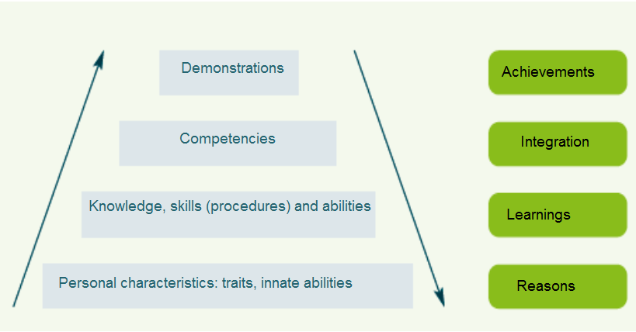
Objectives and outcomes of learning
Learning outcome hierarchy (NCES, 2002)

Slide 10
Teaching - learning contents
Contents:
Those to be learned to develop the capabilities related to the objectives and that will allow them to be competent.
They can be:
Conceptual (know): knowing the periodic table
Procedural (know how): perform an experiment
Attitudinal (how): scientific rigor
They are often organized in thematic blocks

Slide 11
Methodological strategies
Select training and evaluation methodologies (diverse) adapted to competencies and resources available
Activity
professor
student
Methodology
Master C.
Case study
PBL
Projects
Autonomous work

Slide 12
The activities
These are the actions to be performed to learn the contents that will develop the skills...
Typology according to:
Grouping: individual, group, class,....
Context: classroom, workshop, out of the workshop, ...
Directivity: directed, semi-directed, free...
Format: comments, problems, simulations...
Code: written, oral, iconic...
...

Slide 13
Possible activities for the student
IN PERSON T-L (Classroom) |  | DIRECTED T-L (Out of the classroom) |  | AUTONOMOUS T-L (Out of the classroom)
Student | Professor | Student | Professor | Student | Professor
Take notes Student exposure: individual or in group Guest exposure Debates (seminars, discussion forums, etc.) Group work Simulations (role-playing) Cinema-forum Exam ……….. |  | Tutorial project Case study Virtual forum participation Oriented reading Tutorials: in person or virtual Individual or team works. Guided visits ………….. |  | Readings Personal study: preparation Exams, notes and/or material organization Information search Free tutorials: individual or group. …………..
- STUDENT LEADING ROLE +
+ PROFESSOR LEADING ROLE +

Slide 14
Activities selected for the student
IN PERSON T-L (Classroom) |  | DIRECTED T-L (Out of the classroom) |  | AUTONOMOUS T-L (Out of the classroom)
Student (50 hours) | Professor (50 hours) | Student (80 hours) | Professor (30 hours) | Student (20 hours) | Professor
Take notes (subjects 1 to 4, 7 and 12) Student exposure: individual or in group Guest exposure Debate on…….(topic 5) Group work Simulation on…….(topic 6) Projection on…(topic 12). Case creation ……….. |  | Tutorial project (topics 1 to 9) Individual or team works. Case study (topics 13 and 14) Oriented reading (topics Virtual forum participation (topics 10, 11 and 15) Guided visits ………….. |  | Readings (topics 10, 11) Personal study: preparation Exams, notes and/or material organization Information search Free tutorials: individual or group. …………..
- STUDENT LEADING ROLE +
+ PROFESSOR LEADING ROLE +

Slide 15
Search of coherence
Competence | Strategy used in training and evaluation | Tool used to collect evidences
Respect diversity and plurality of ideas, people and situations. | Debates/ Discussion groups | Checklist
Apply quality management models in specific contexts. | Case solution | Outcome test
Design plans, programs and projects adapted to educational and training contexts. | Project | Evaluation matrix
Know how to communicate effectively, both in own languages and in a third language. | Oral presentation | Observation grid
Critically analyze the staff job and use resources for professional development. | Binders | Self assessment grid

Slide 16
Resources
To develop the syllabus:
bibliography (compulsory, basic, additional, commented)
webs, virtual bays...
document centers...
Scripts for tasks.
Documentary dossiers
Audiovisual and computer means

Slide 17
Learning time
Estimate work hours of the student in training to develop the objectives
Possible options
A B C
Assessable executions
IN PERSON T-L
(Classroom/Workshop)
75%
50%
25%
Involvement
Exams
Tasks
…….
DIRECTED T-L
(Out of the classroom/workshop)
25%
40%
55%
Involvement
Observance of rules
Quality of contributions
……..
AUTONOMOUS T-L
(Out of the classroom/workshop)
10%
20%
Self assessment
Portfolio
……….

Slide 18
Programming classroom activities
IDENTIFICATION DATA
Name and last names:
Course:
Name of the activity:
Topic block:
Type of activity
Theory
Application
Laboratory
…………
Compulsory
Optional
Free
…………
Individual
In group
All the class
…………
Reading
Work practice
Case study
………….
Paper
Oral pres.
Internet
………..
Starting week:
Delivery week:
Estimated hours:
Evaluation criteria:
Feedback to the student:
Individual correction
Group correction
Publication
………..
PRESENTATION OF THE ACTIVITY
Description of the activity:
Desired objectives:
Related competences:
Sources of information:
Other usable resources:

Slide 19
Design of training activities
2nd Training in Saltillo, MEX
17-20th of December 2018
JOAQUÍN GAIRÍN SALÁN (UAB)
"The European Commission support for the production of this publication does not constitute an endorsement of the contents which reflects the views only of the authors, and the Commission cannot be held responsible for any use which may be made of the information contained therein.“
FOR EDUCATIONAL PURPOSE ONLY

